Slide 1
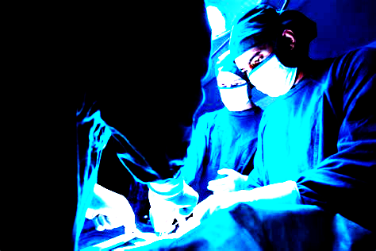
Clinical Decision Support System for OR Case Length Prediction
Brandon Gambrall
SAT5141 CDSS
12/5/2025

Slide 2
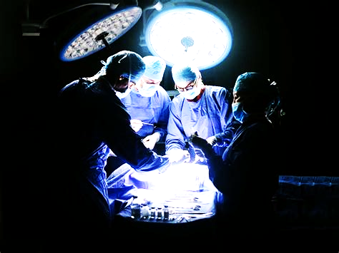
CONTENTS
01
INTRODUCTION
02
ML FRAMEWORK
03
FINDINGS
04
ANALYSIS
05
CONCLUSION
SAT5141

Slide 3
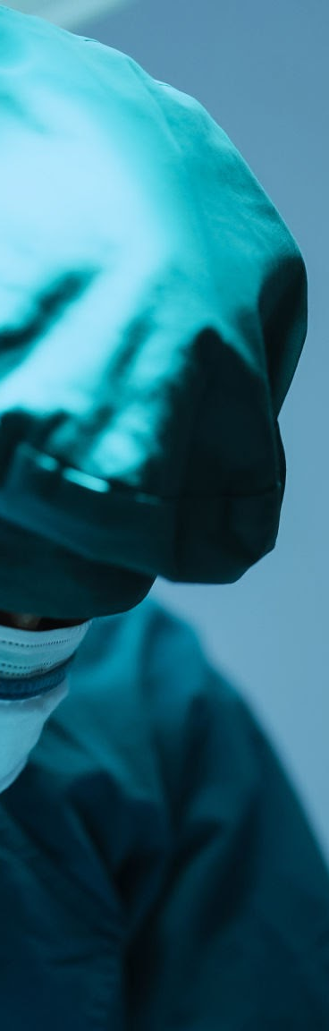
1
INTRODUCTION
The biggest cause of chaos:
OR schedule
Major cause of tension between staff, management, and amongst providers.
Block Time, Releases, and Add Ons
Tale of two practices:
-Overestimate case to preserve block time
-Underestimate case to squeeze more
CDSS to Generate Predicted Case Time to support scheduler
Project started out as classification moved to regression

Slide 4
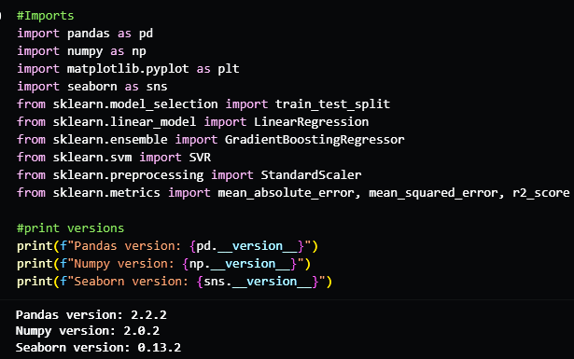
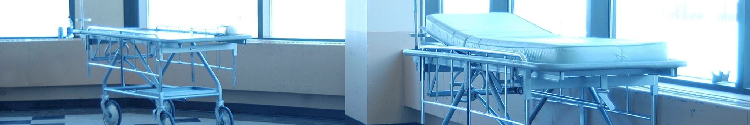
ML FRAMEWORK
2
IMPORTS
DATASET PATH/DF HEAD
PREPROCESSING
TARGET/FEATURE SELECTION
SPLIT
LR/SVR/GBR MODELS
MODEL EVALUATIONS/ANALYSIS
MODEL SELECTION
SAT5141

Slide 5
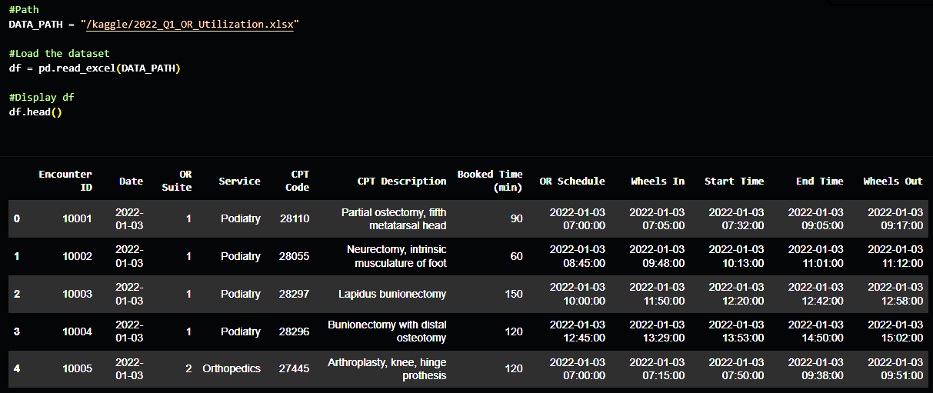
ML FRAMEWORK
2
IMPORTS
DATASET PATH/DF HEAD
PREPROCESSING
TARGET/FEATURE SELECTION
SPLIT
LR/SVR/GBR MODELS
MODEL EVALUATIONS/ANALYSIS
MODEL SELECTION
SAT5141

Slide 6
ML FRAMEWORK
2
IMPORTS
DATASET PATH/DF HEAD
PREPROCESSING
TARGET/FEATURE SELECTION
SPLIT
LR/SVR/GBR MODELS
MODEL EVALUATIONS/ANALYSIS
MODEL SELECTION
Removed Columns that added no value, redundant value/cause data leak:
Wheels In/Out, Start/End, OR Schedule Start Time, Date, Booked Time
Checked for Null Values or 0 values (Cancelled cases.
SAT5141

Slide 7
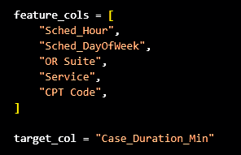
ML FRAMEWORK
2
IMPORTS
DATASET PATH/DF HEAD
PREPROCESSING
TARGET/FEATURE SELECTION
SPLIT
LR/SVR/GBR MODELS
MODEL EVALUATIONS/ANALYSIS
MODEL SELECTION
SAT5141

Slide 8
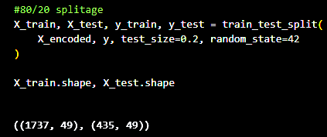
ML FRAMEWORK
2
IMPORTS
DATASET PATH/DF HEAD
PREPROCESSING
TARGET/FEATURE SELECTION
SPLIT
LR/SVR/GBR MODELS
MODEL EVALUATIONS/ANALYSIS
MODEL SELECTION
SAT5141

Slide 9
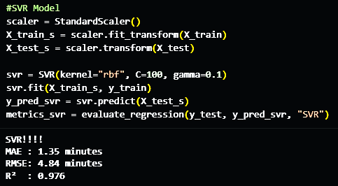
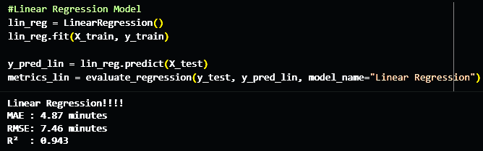
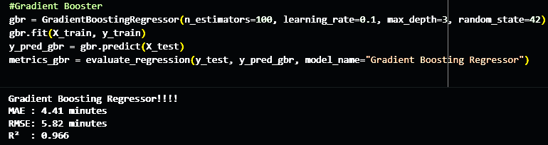
FINDINGS
3
IMPORTS
DATASET PATH/DF HEAD
PREPROCESSING
TARGET/FEATURE SELECTION
SPLIT
LR/SVR/GBR MODELS
MODEL EVALUATIONS/ANALYSIS
MODEL SELECTION
SAT5141

Slide 10
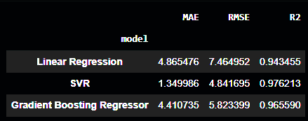
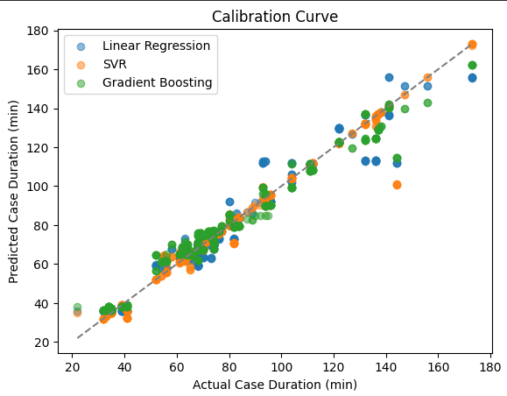
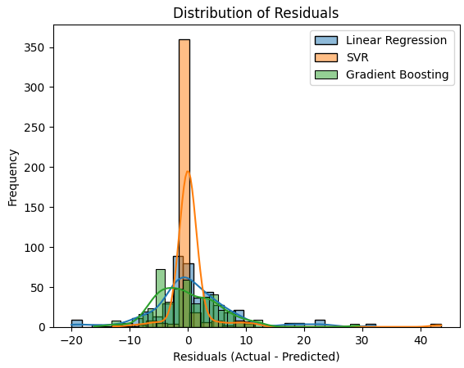
ANALYSIS
4
IMPORTS
DATASET PATH/DF HEAD
PREPROCESSING
TARGET/FEATURE SELECTION
SPLIT
LR/SVR/GBR MODELS
MODEL EVALUATIONS/ANALYSIS
MODEL SELECTION
SAT5141

Slide 11
ANALYSIS
4
IMPORTS
DATASET PATH/DF HEAD
PREPROCESSING
TARGET/FEATURE SELECTION
SPLIT
LR/SVR/GBR MODELS
MODEL EVALUATIONS/ANALYSIS
MODEL SELECTION
SVR showed the strongest model:
Tighter Residuals
Higher R2 value
Honorable Mentions:
GBR did well but had some outliers that were +/- 20 to 30 min
Lin model was fair but had a long positive tail and underestimated long cases.
SAT5141

Slide 12
WORK CITED
SAT5141
B, Arunachalam. “How to Build a Linear Regression Model – Machine Learning Example.” freeCodeCamp.Org, freeCodeCamp.org, 6 Sept. 2023, www.freecodecamp.org/news/build-a-linear-regression-model-with-an-example/.
Falk, J. (2022). Operating Room Utilization. Kaggle. https://www.kaggle.com/datasets/thedevastator/optimizing-operating-room-utilization
Hembroff, Guy. “SAT5141 Disease Progression.” CAS, SAT5141, mtu.instructure.com/courses/1575642/pages/part-i-disease-progression-modeling-dpm. Accessed 20 Nov. 2025.
Saraswat, Manish. “Beginners Guide to Regression Analysis and Plot Interpretations Tutorials & Notes: Machine Learning.” HackerEarth, www.hackerearth.com/practice/machine-learning/machine-learning-algorithms/beginners-guide-regression-analysis-plot-interpretations/tutorial/. Accessed 5 Dec. 2025.
“Support Vector Regression (SVR) Using Linear and Non-Linear Kernels in Scikit Learn.” GeeksforGeeks, GeeksforGeeks, 6 Aug. 2025, www.geeksforgeeks.org/machine-learning/support-vector-regression-svr-using-linear-and-non-linear-kernels-in-scikit-learn/.

Slide 13
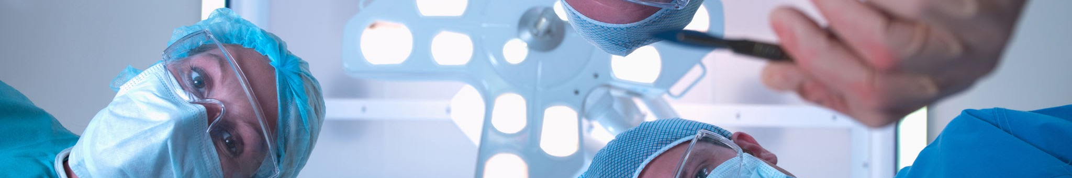
THANK YOU
SAT5141

